Slide 1
Growing Hydra
Phoebe Colvin Oehmig, Middlebury College
Notes:
First off, I want to say thank you for letting me be a part of EDAB this summer, and I can’t believe tomorrow is my last day, but I’m excited to get share with you what I’ve been working on this summer, which is Growing Hydra!

Slide 2
Hydra is a Model For Ecosystem based Fisheries Management
Changes in the environment
Fishing +
Interactions among species
Notes:
First off as many of you know…
Hydra is a model for Ecosystem Based Fisheries Management which takes a Holistic approach to managing fish species
The cool thing about Ecosystem based fisheries management is that it considers NOT ONLY fishing, but also interactions with other species + effects of changes in the environment including climate change and pollution that put stress on the ecosystem
The goal of EBFM is to insure healthy + productive + resilient ecosystems that can provide us with various ecosystem services

Slide 3
Place-based management
Length Based
Multispecies
Multi-fleet
Notes:
So this is done through a concept called place-based management, and Hydra which is
a length based, multispecies, multi-fleet model is currently focused on George’s Bank.

Slide 4
H
Y
D
R
A
Population of the Species
Fish interaction (predator/prey relationships, stomach content/volume)
Fishing
(Landings by gear type)
Growth
(expressed by length/weight and von Bertalanffy growth curves)
Simulator of # of Recruits
Notes:
Currently the model simulates the
-reproduction,
-interaction,
-harvesting,
and growth of ten species.
These current species account for approximately 90 percent of landings on Georges Bank from 1977-2014.

Slide 5
1. Spiny dogfish
Squalus acanthias (Squalidae)

Slide 6
2. Winter skate
Leucoraja ocellata (Rajidae)

Slide 7
3. Atlantic Cod
Gadus morhua (Gadidae)

Slide 8
4. Atlantic Herring
Clupea harengus (Clupeidae)

Slide 9
5. Haddock
Melanogrammus aeglefinus (Gadidae)

Slide 10
6. Atlantic Mackerel
Scomber scombrus (Scombridae)

Slide 11
7. Winter Flounder
Pseudopleuronectes americanus (Pleuronectidae)

Slide 12
8. Yellowtail flounder
Limanda ferruginea (Pleuronectidae)

Slide 13
9. Monkfish/Goosefish
Lophius americanus (Lophiidae)

Slide 14
10. Silver hake
Merluccius bilinearis (Merlicciidae)

Slide 15
What to Feed the beast
Maximum length of a fish
Distribution/range
Length at age
Length and weight
Stomach content
Predators and prey
Fishing gear types
Notes:
So my task was to determine certain parameters for the new species that I was adding:
Theses parameters were:
-The maximum length the fish can grow -The species distribution and range - the Length at age and
length and weight information and data -Stomach content data - and to Determine predators and prey -as well as the types of fishing gear used to catch the species

Slide 16
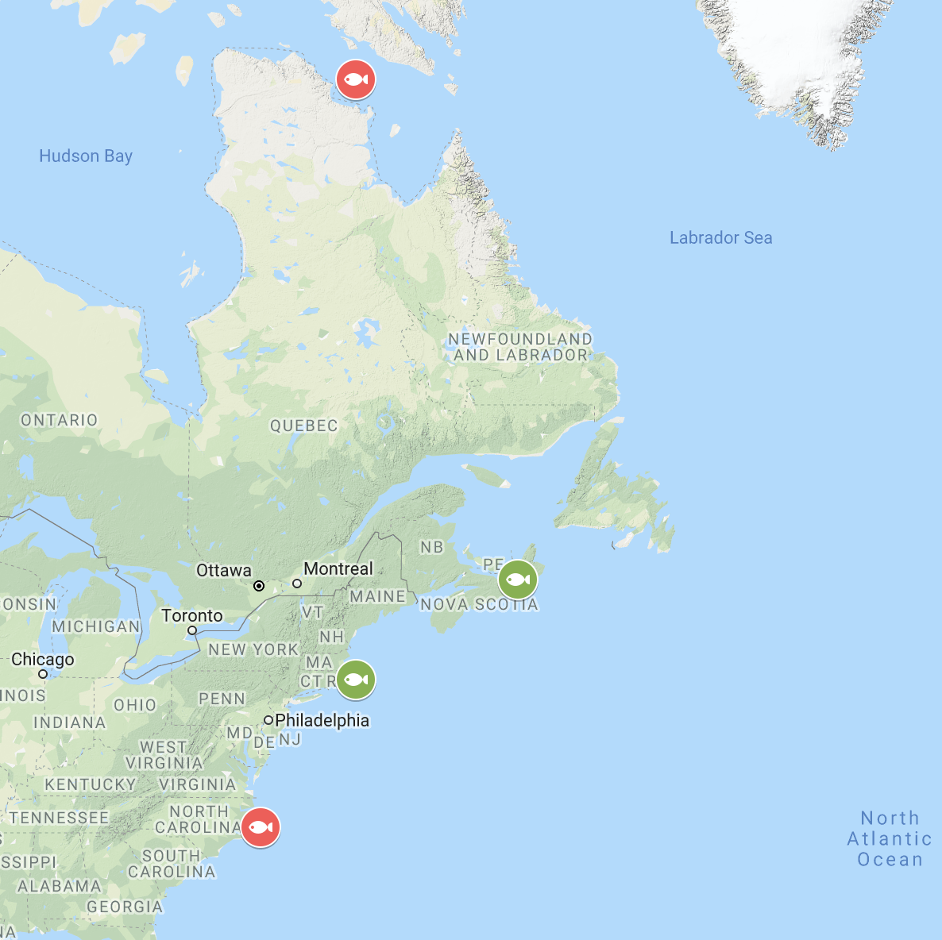
Pollock (Pollachius virens)
Benthopelagic
North Carolina to Hudson Straight, Canada
Mainly between Cape Cod and Strait of Canso, Nova Scotia
Maximum Length: 130 cm
Notes:
Benthopelagic
North Carolina to Hudson Straight, Canada
Mainly between Cape Cod and Strait of Canso, Nova Scotia
Maximum Length: 130 cm

Slide 17
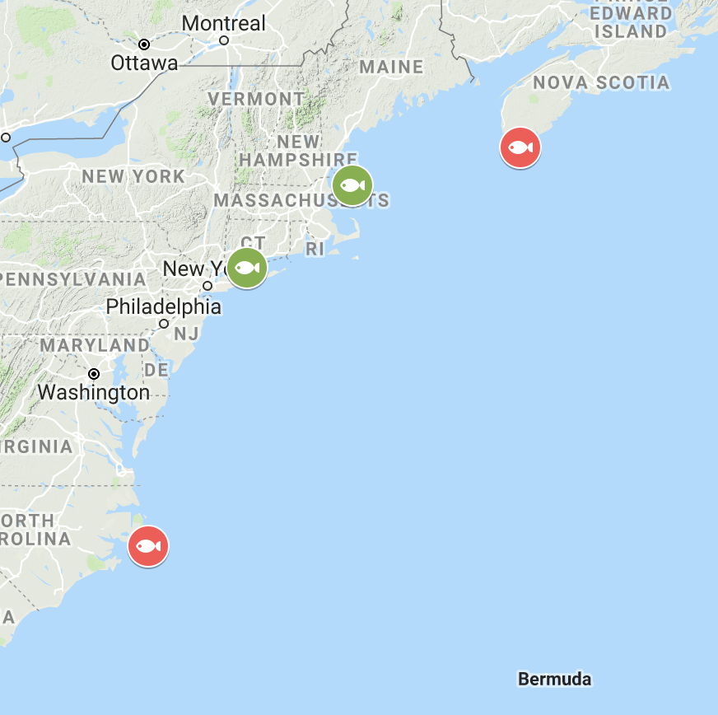
Red Hake (Urophycis chuss)
Demersal
North Carolina to Southern Nova Scotia
Most abundant from Southern New England to Western Gulf of Maine
Maximum length: 66 cm
Notes:
Demersal
North Carolina to Southern Nova Scotia
Most abundant from Southern New England to Western Gulf of Maine
Maximum length: 66 cm

Slide 18
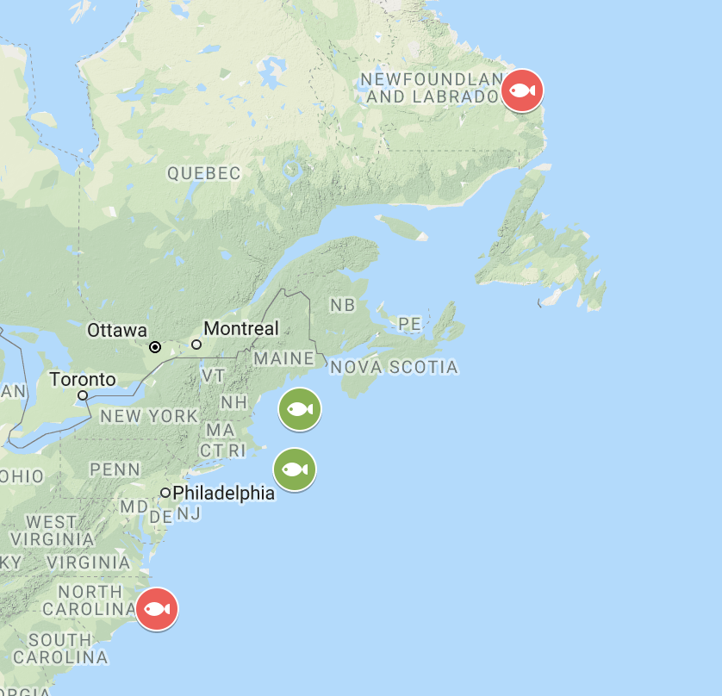
White Hake (Urophycis Tenuis)
Demersal
North Carolina to Newfoundland
Mainly found in the Gulf of Maine and George’s Bank
Maximum length= 133 cm
Notes:
Demersal
North Carolina to Newfoundland
Mainly found in the Gulf of Maine and George’s Bank
Maximum length= 133 cm

Slide 19
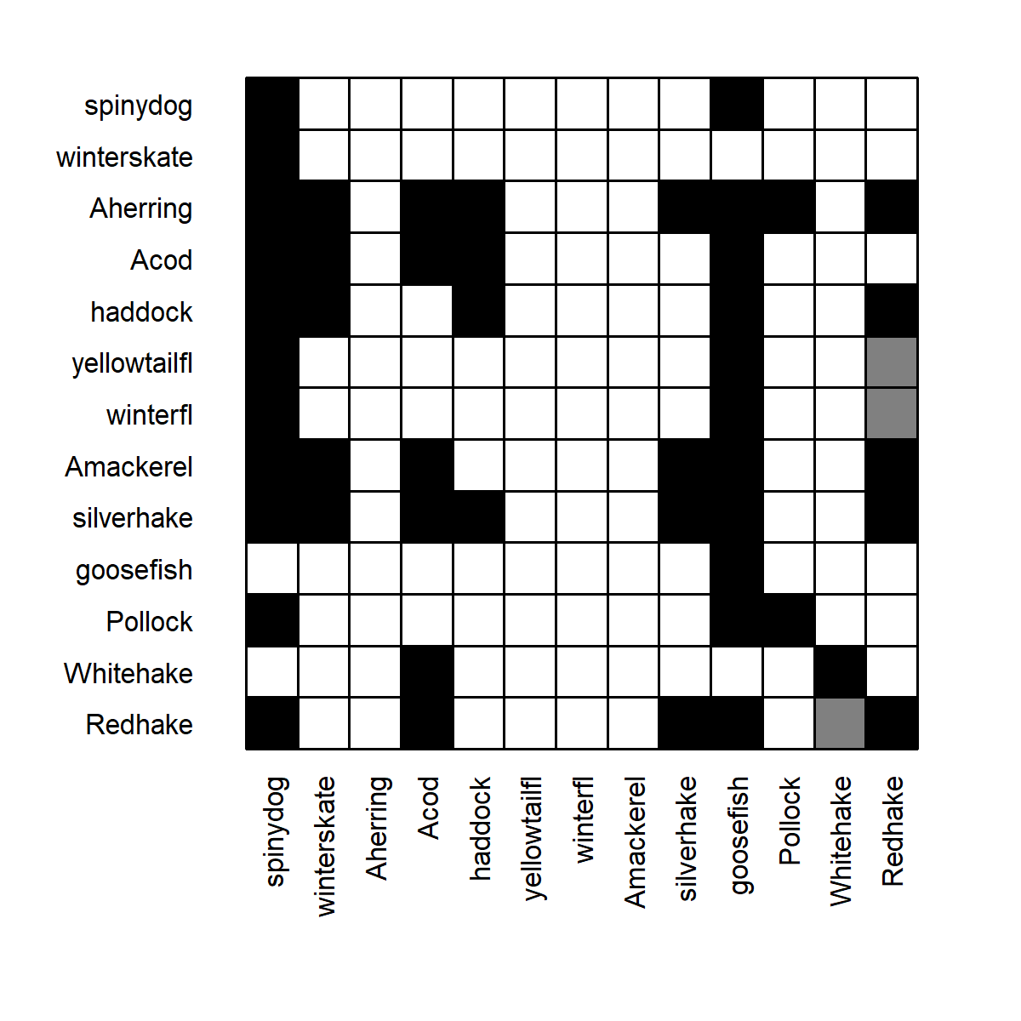
Where do these species fit into Hydra?
Pollock
Prey
- smaller Pollock and Atlantic Herring
Predators
-Spiny Dogfish, Goosefish/Monkfish
White Hake
Prey
- smaller White Hake and Red Hake (?)
Predators
-Atlantic Cod, bigger White Hake
Red Hake
Prey
- smaller Red Hake, Silver Hake, Atlantic Mackerel, Winter Flounder, Yellowtail Flounder, Haddock, Atlantic Herring
Predators
- Spiny Dogfish, Atlantic Cod, Silver Hake, Goosefish/Monkfish, Red Hake, and White Hake (?)
Prey
Predator
Notes:
From the information I found on the species directory on the NOAA website I was able to determine that…
Pollock
Prey
- smaller Pollock and Atlantic Herring
Predators
-Spiny Dogfish, Goosefish/Monkfish
White Hake
Prey
- smaller White Hake and Red Hake (?)
Predators
-Atlantic Cod, bigger White Hake
Red Hake
Prey
- smaller Red Hake, Silver Hake, Atlantic Mackerel, Winter Flounder, Yellowtail Flounder, Haddock, Atlantic Herring
Predators
- Spiny Dogfish, Atlantic Cod, Silver Hake, Goosefish/Monkfish, Red Hake, and White Hake (?)

Slide 20
H
Y
D
R
A
Population of the Species
Fish interaction (predator/prey relationships, stomach content/volume)
Fishing
(Landings by gear type)
Growth
(expressed by length/weight and von Bertalanffy growth curves)
# of Recruits
Notes:
So the first information needed to add a new species is to know the population of the species

Slide 21
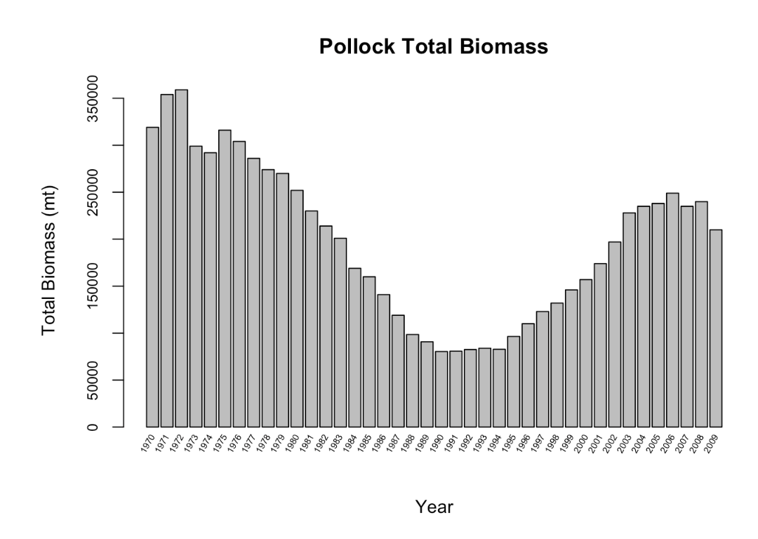
Estimated Population of Pollock
Gulf of Maine (sub area 5)
George’s Bank (sub area 6)
including Eastern George’s Bank (subdivision 5Zc)
Data Source: SAW Report, 2010
Notes:
As an example...
This data for Pollock came from the 2010 SAW Report
Gulf of Maine (in NAFO sub area sub area 5)
George’s Bank (sub area 6)
including Eastern George’s Bank (subdivision 5Zc)

Slide 22
H
Y
D
R
A
Population of the Species
Fish interaction (predator/prey relationships, stomach content/volume)
Fishing
(Landings by gear type)
Growth
(expressed by length/weight and von Bertalanffy growth curves)
# of Recruits
Notes:
Next step is to simulate the # of Recruits

Slide 23
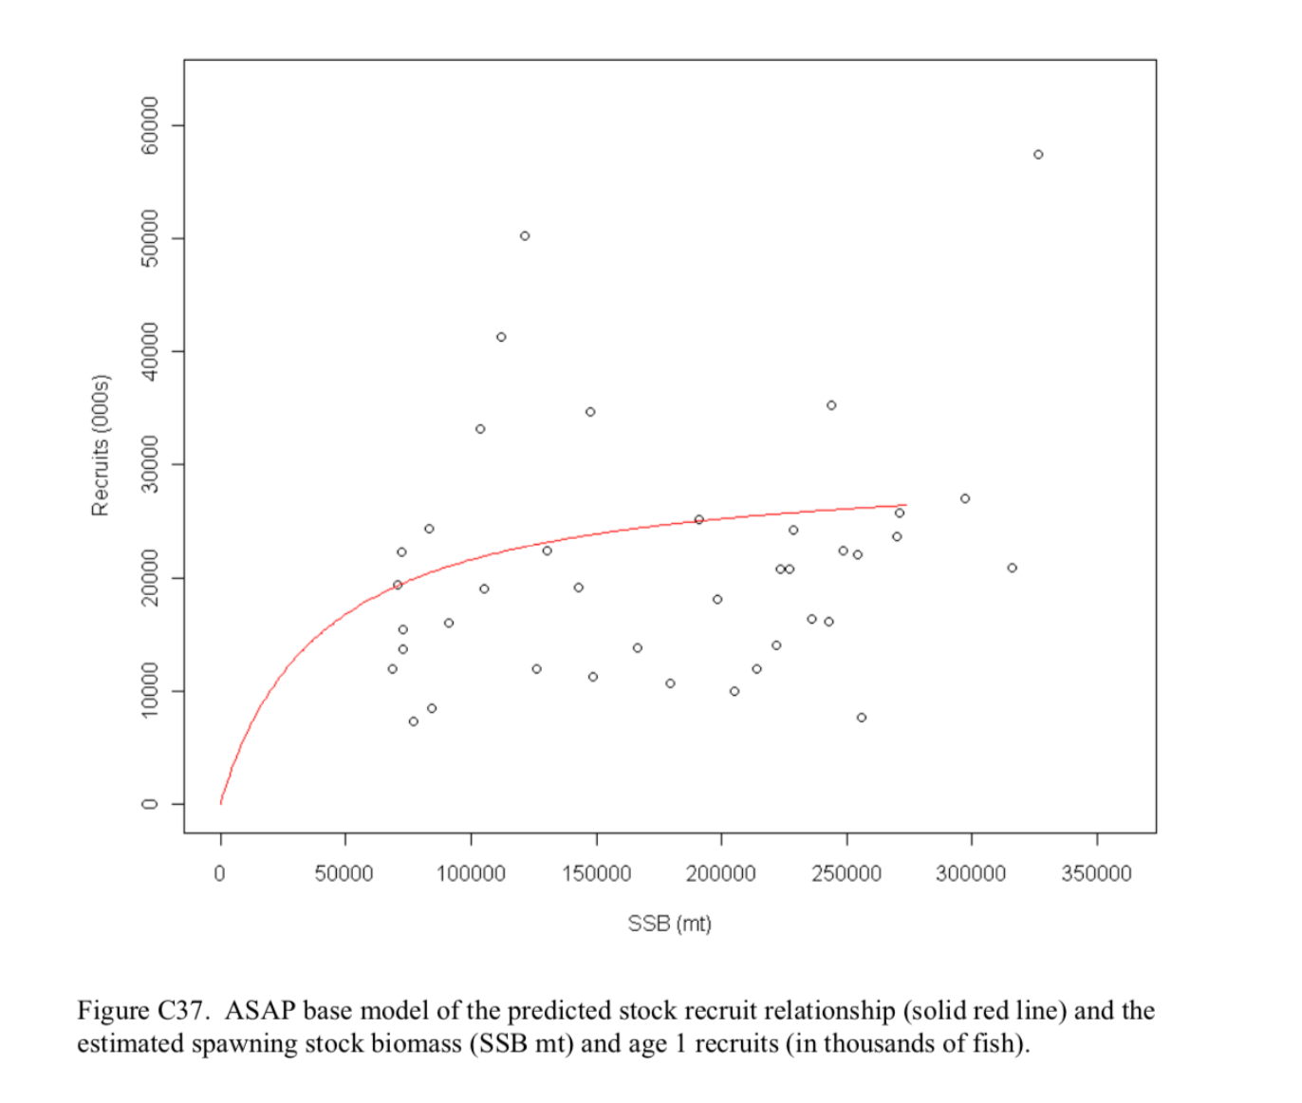
Pollock Recruitment
Beverton-Holt form
21 million age 1 recruits
Derived from SAW Report, 2010
Notes:
-This shows the predicted stock recruit relationship (the red line) plotted against the estimated spawning stock biomass
-Recruitment was assumed to follow a Beverton-Holt functional form which determined that the
mean recruitment was around
21 million age 1 recruits.

Slide 24
H
Y
D
R
A
Population of the Species
Fish interaction (predator/prey relationships, stomach content/volume)
Fishing
(Landings by gear type)
Growth
(expressed by length/weight and von Bertalanffy growth curves)
# of Recruits
Notes:
The next part in included is the fish interactions,
which include predator/prey relationships and
stomach content and volume

Slide 25
Predator and Prey Relationships
Pollock
Prey
- smaller Pollock and Atlantic Herring
Predators
-Spiny Dogfish, Goosefish/Monkfish
White Hake
Prey
- smaller White Hake and Red Hake (?)
Predators
-Atlantic Cod, bigger White Hake
Red Hake
Prey
- smaller Red Hake, Silver Hake, Atlantic Mackerel, Winter Flounder, Yellowtail Flounder, Haddock, Atlantic Herring
Predators
- Spiny Dogfish, Atlantic Cod, Silver Hake, Goosefish/Monkfish, Red Hake, and White Hake (?)
Prey
Predator
Notes:
As you saw before, here are the predator prey relationships for the three species

Slide 26
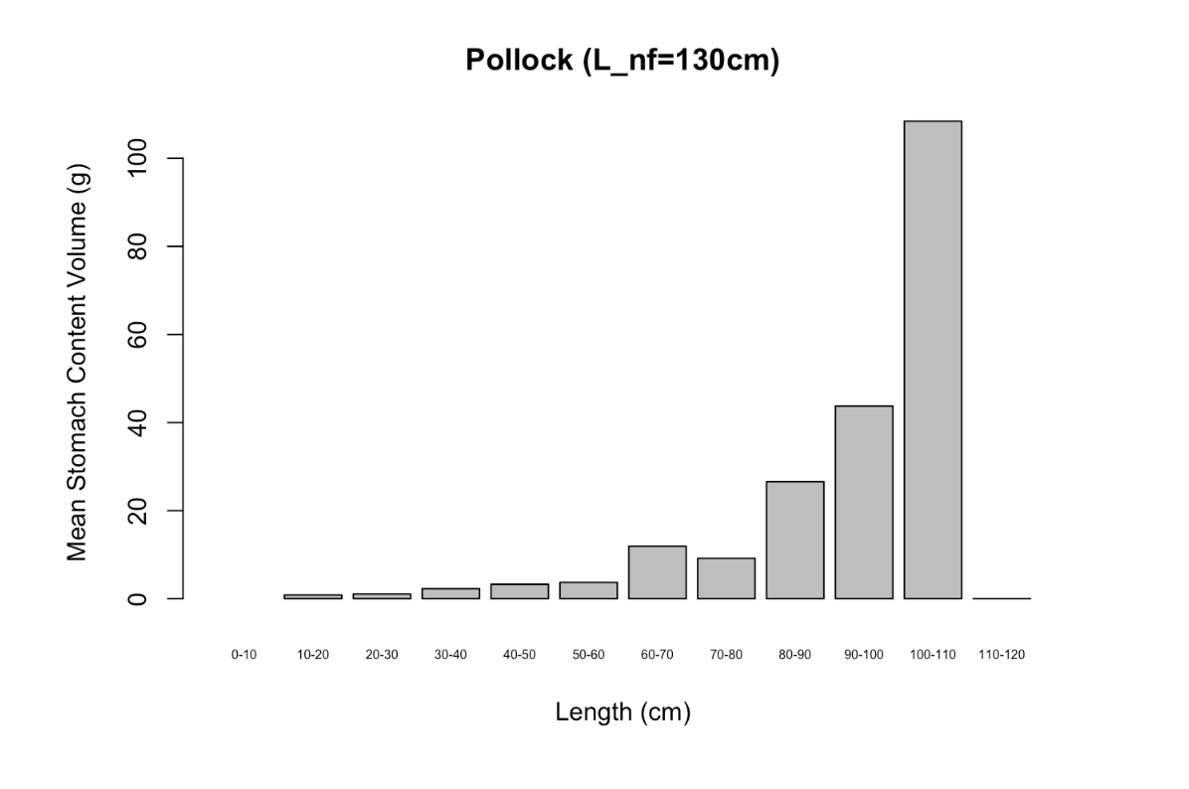
Stomach Content Volume
Pollock
Volume increases with fish size
Data Source: Food Habits data collected on annual surveys
Notes:
I also plotted the stomach content volume for each species.
Pollock is shown here, and as predicted the volume increases with fish size

Slide 27
H
Y
D
R
A
Population of the Species
Fish interaction (predator/prey relationships, stomach content/volume)
Fishing
(Landings by gear type)
Growth
(expressed by length/weight and von Bertalanffy growth curves)
# of Recruits
Notes:
Fishing is next added into the equation

Slide 28
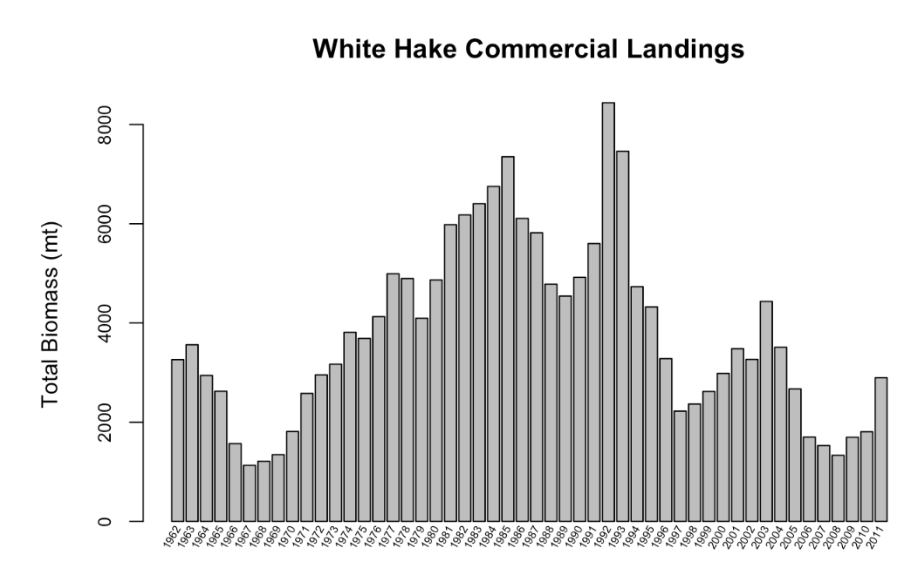
Commercial Landings
White Hake
Landings from George’s Bank and the Gulf of Maine (NAFO sub areas: 5, 6, 464, 465)
Data source: SAW Report, 2013

Slide 29
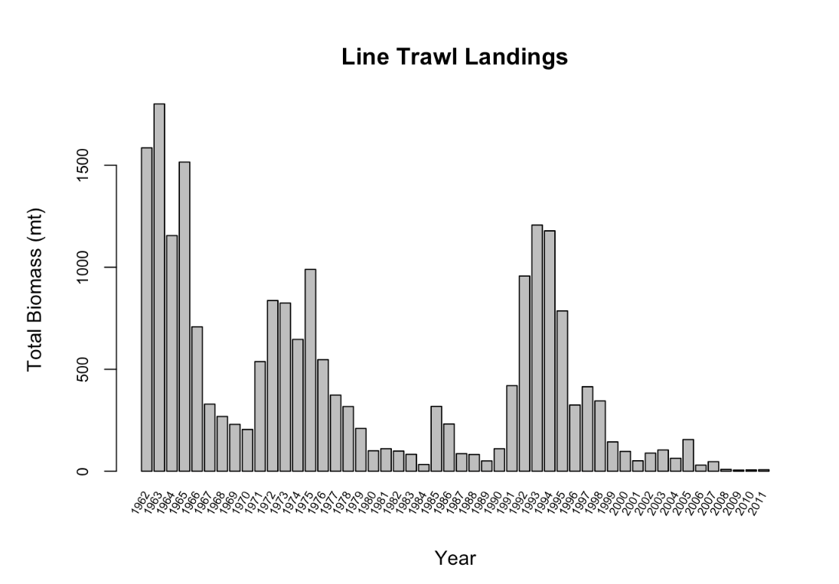
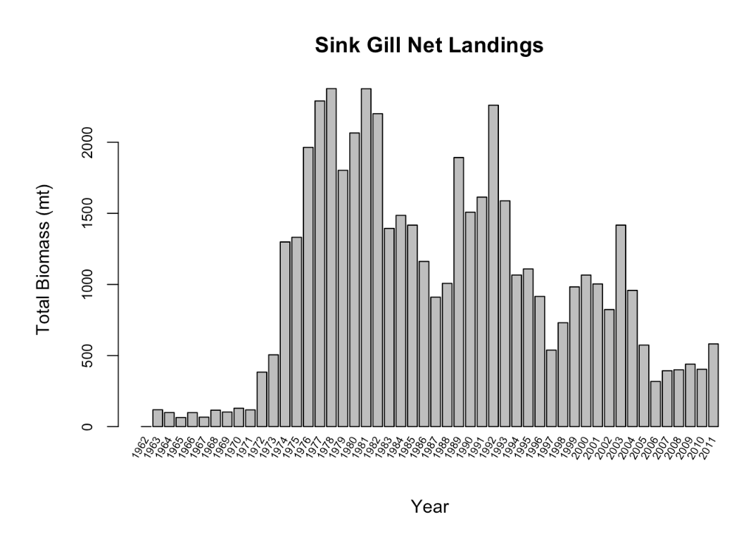
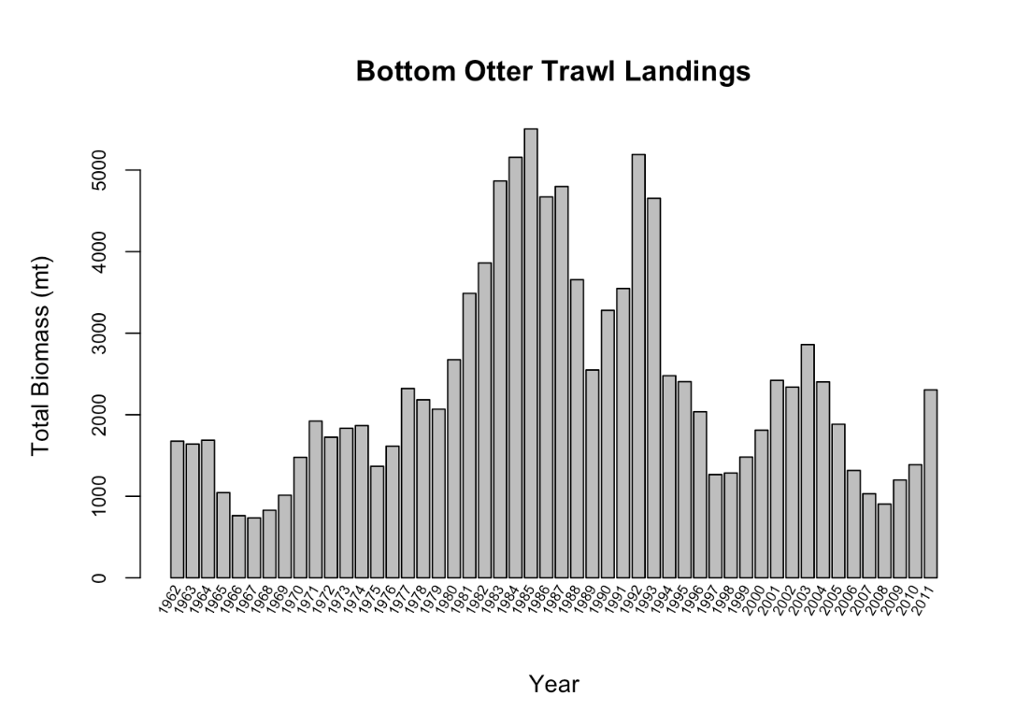
White hake Landings by gear type
Data source: SAW Report, 2013
Notes:
Sink gill net + bottom otter trawl + line trawl landings were the most popular.

Slide 30
H
Y
D
R
A
Population of the Species
Fish interaction (predator/prey relationships, stomach content/volume)
Fishing
(Landings by gear type)
Growth
(expressed by length/weight and von Bertalanffy growth curves)
# of Recruits
Notes:
Growth is the next portion of the simulation and
was expressed by length/weight and von Bertalanffy growth curves

Slide 31
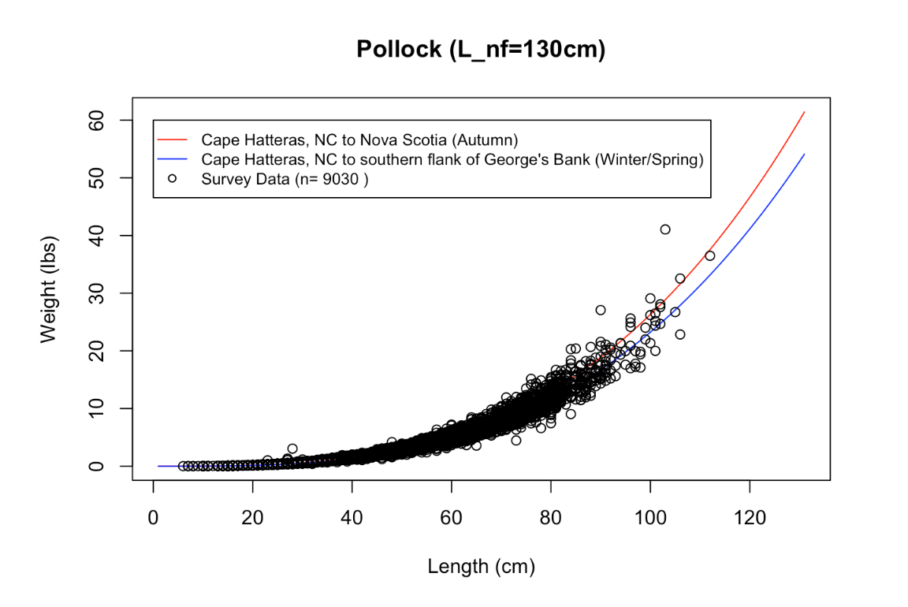
Growth Curves: Length versus weight
Expressed by: W=a∗L^{b}
Autumn surveys (Wigley et al., 2003)
Cape Hatteras, North Carolina to Nova Scotia, Canada
a= 0.000007244
b= 3.1151
Winter/Spring (Wigley et al., 2003)
Cape Hatteras, North Carolina to the Southern Flank of George’s Bank
a= 0.000006788
b= 3.1024.
Survey Data
Collected during NEFSC research bottom trawl surveys from 1992 to 1999
Notes:
The relationship between Pollock length (cm) and weight (lbs) as expressed by weight = A x Length to the B
Autumn surveys: were conducted from Cape Hatteras, North Carolina to Nova Scotia, Canada
Winter/Spring surveys were conducted from Cape Hatteras, North Carolina to the Southern Flank of George’s Bank.
Survey Data was collected during NEFSC research bottom trawl surveys from 1992 to 1999.

Slide 32
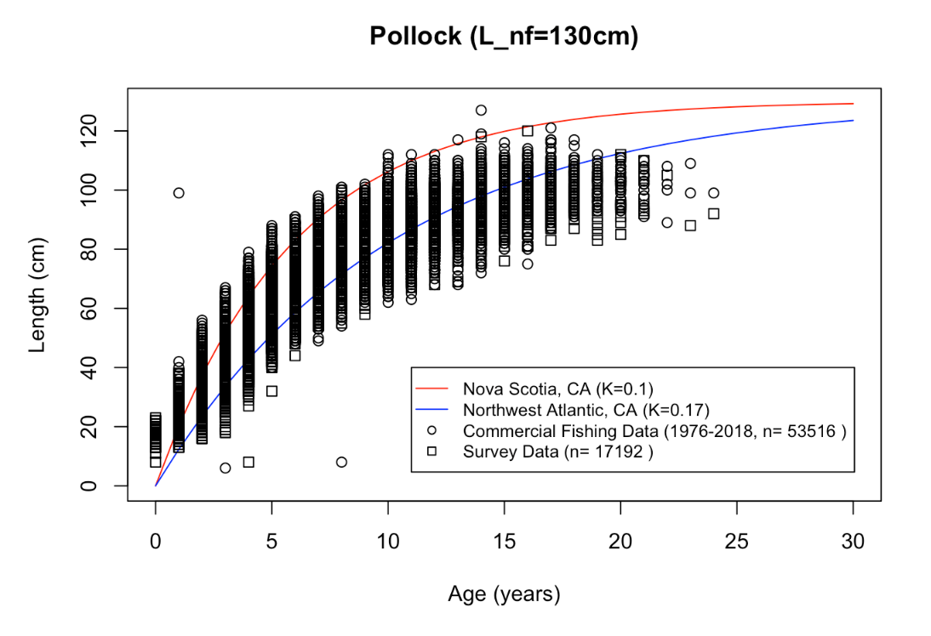
Growth Curves: Length Versus Age
Expressed by von Bertalanffy:
` Linf∗(1−exp(−k∗t))
Nova Scotia, Canada (Erzini, 1991)
K= 0.1
Northwest Atlantic, Canada (Erzini, 1991)
K= 0.17
Commercial Fishing Data
Gathered 1976- 2018
Survey Data
Collected during NEFSC research bottom trawl surveys from 1992 to 1999
Notes:
-The relationship between Pollock age (yrs) and length (cm) calculated by the von Bertalanffy growth rate for Nova Scotia, Canada and in the Northwest Atlantic, Canada
-These growth rates are compared to commercial fishing data gathered from 1976 to 2018 as well as survey data gathered by NEFSC.
-As you can see the equation for Northwest Atlantic (seen in blue) better fits the commercial fishing and survey data

Slide 33
H
Y
D
R
A
Population of the Species
Fish interaction (predator/prey relationships, stomach content/volume)
Fishing
(Landings by gear type)
Growth
(expressed by length/weight and von Bertalanffy growth curves)
Simulator of # of Recruits
Notes:
Now with the addition of Pollock, white hake, and red hake into Hydra…

Slide 34
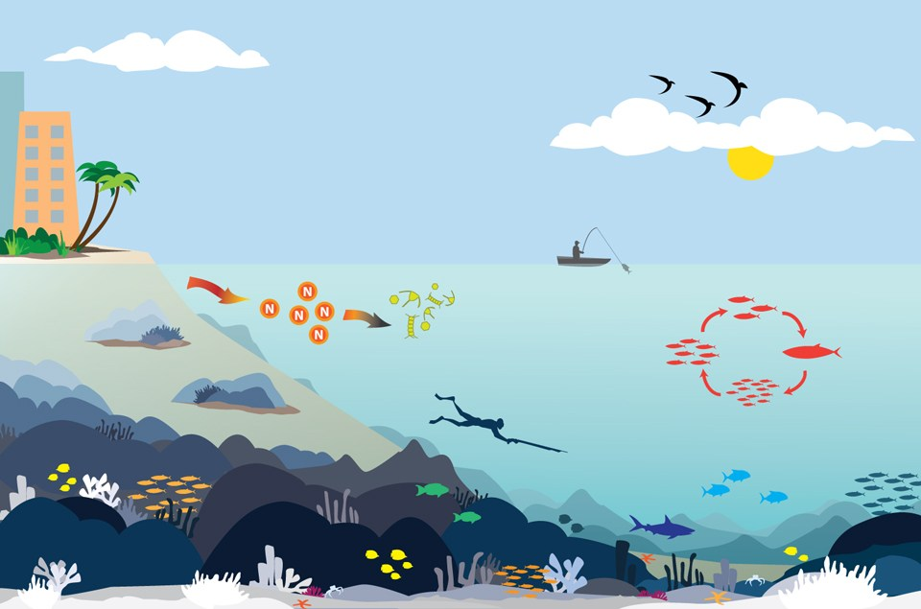
economic development
environmental changes
fishing
species interactions
social considerations
recruitment
growth
Notes:
…social, economic, and ecological trade-offs, including interactions with other species, growth, recruitment, fishing, and environmental changes for these three species can be considered.

Slide 35
Reference Sources
Stock Assessment Workshop (SAW) Reports
Published Scientific Papers
FishBase
Internal NOAA Reference Documents and Databases
Notes:
(despite not having access because of my lack of security clearance, so thank you Andy and Sean for downloading and emailing them to me)!

Slide 36
Acknowledgements
Dr. Scott Large
Andy Beet
Sean Hardison
Notes:
Scott:
-convincing me to do this internship despite my original disinterest
Andy:
-for being so willing to take me on and teach me despite having never taken a computer science, statistics, or a college math class
Sean:
-for adopting me into his cubical, and for constant one on one support
Don’t forget Sarah!

Slide 37
Questions?

